Slide 1
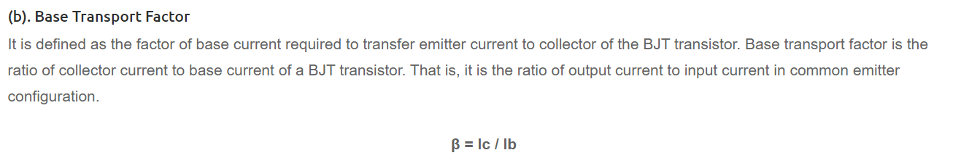
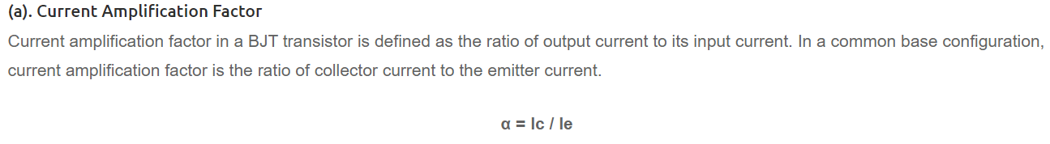
Emitter injection efficiency in a BJT transistor defines the efficiency of majority carrier injection from emitter. It is the ratio of current due to emitter majority carriers to the total emitter current.
The emitter injection efficiency is the ratio of carriers injected into the base from the emitter (forward minority carrier injection) to total carriers injected from the base into the emitter (reverse minority carrier injection) plus forward injection: γ = ien / (ien + iep)

Slide 3
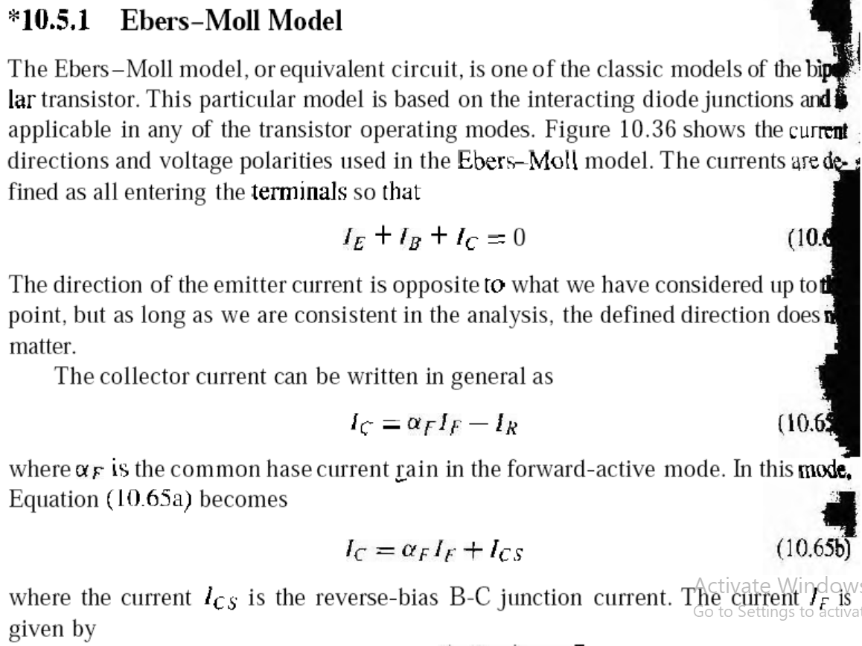

Slide 4
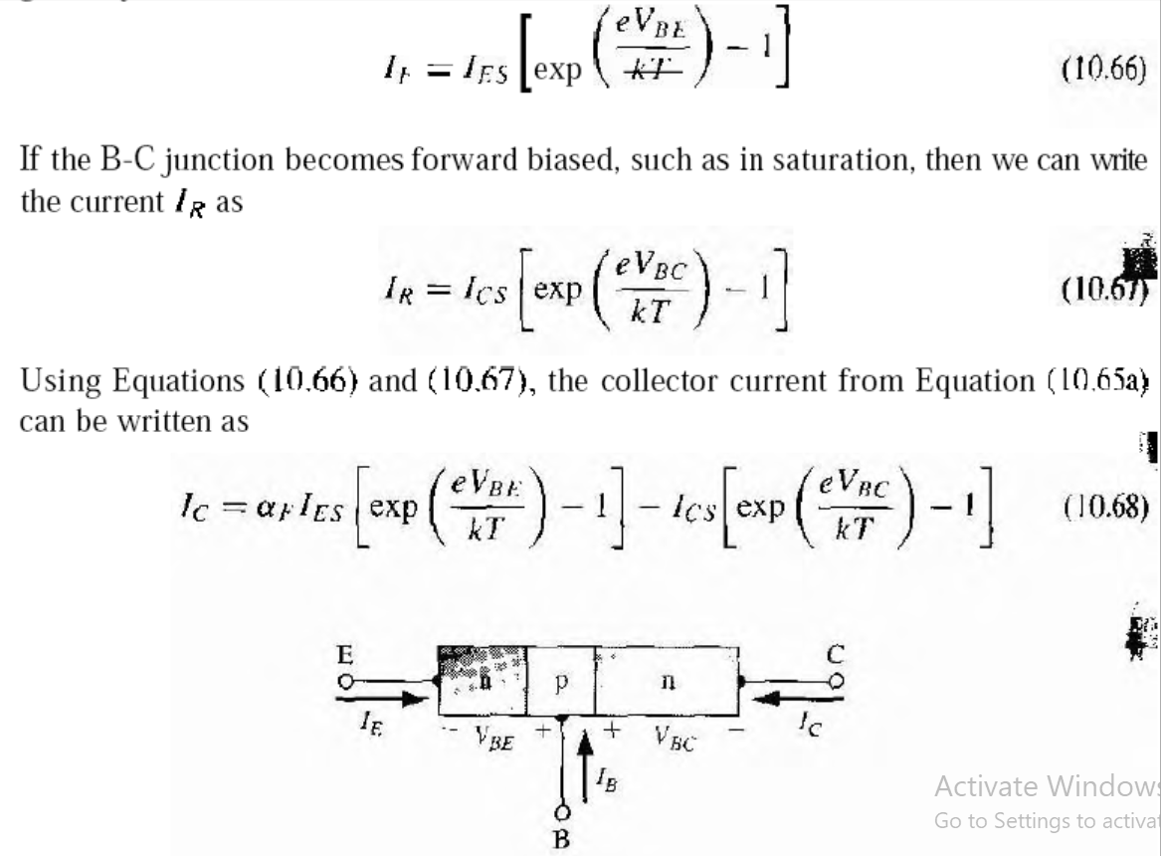
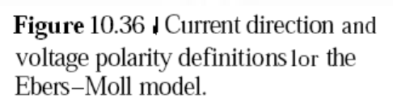

Slide 5
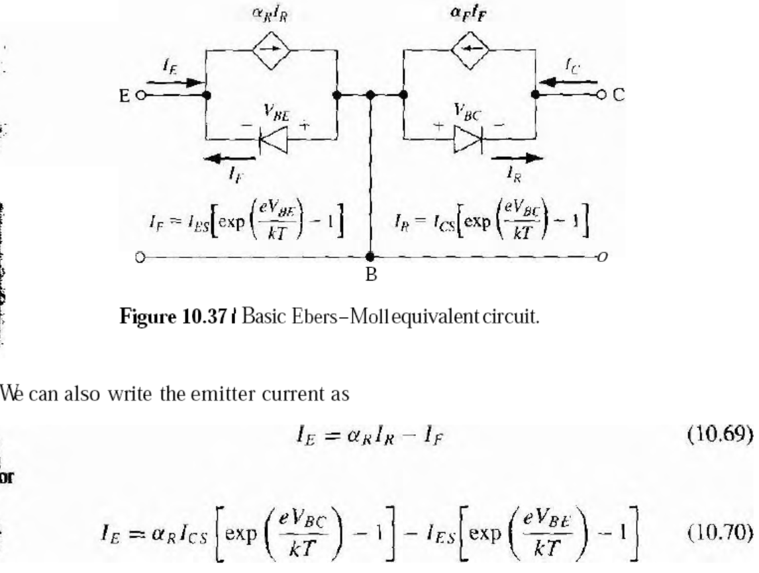

Slide 6
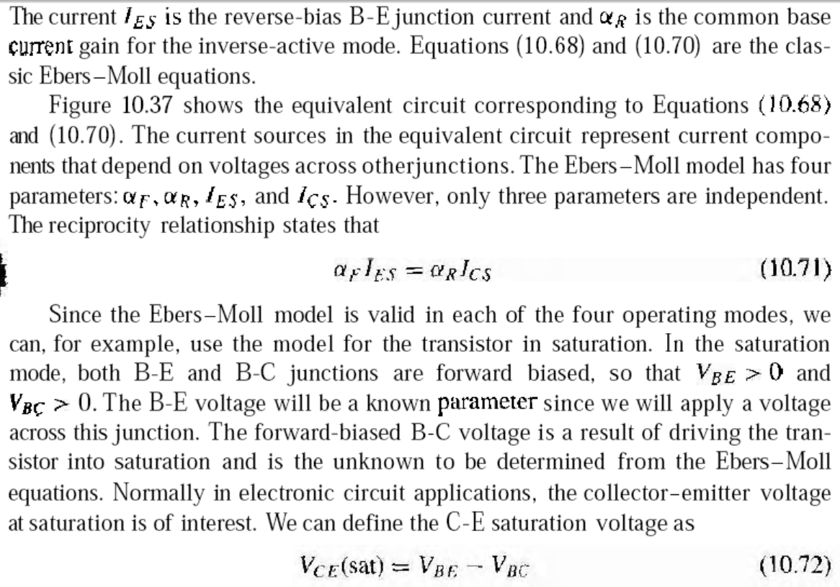
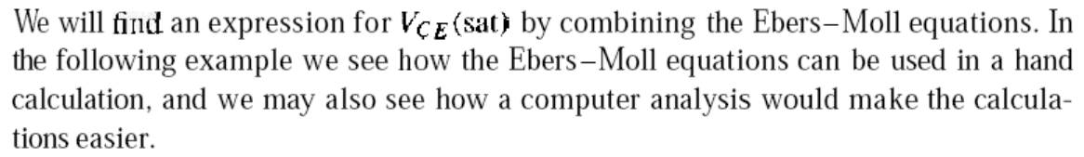
Notes:
aaaa

Slide 7
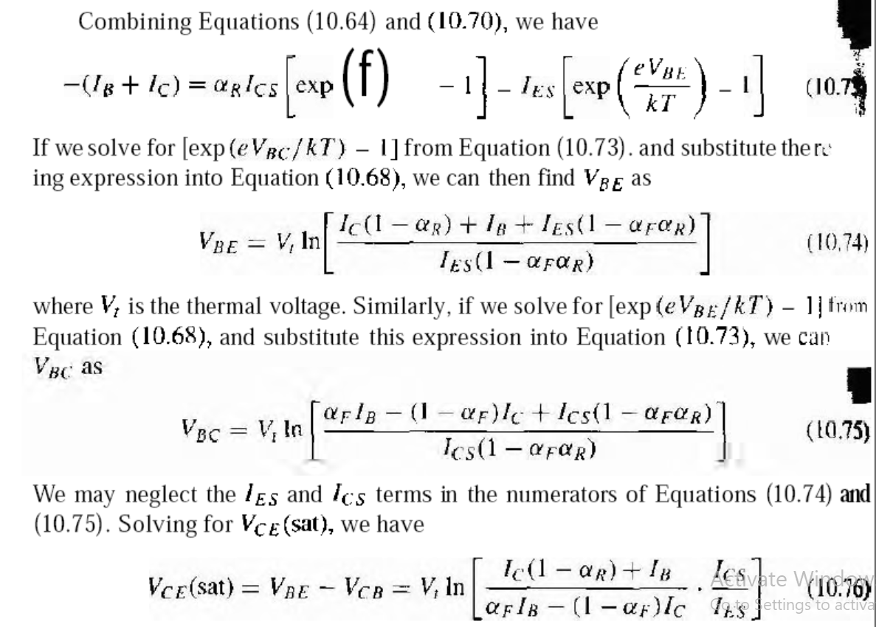
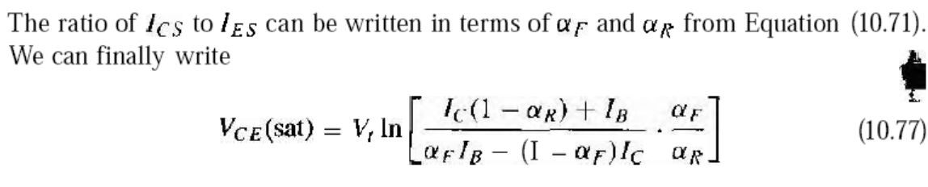

Slide 8
